Slide 1
Introduction to STATA
Richard Lombardo
September 2022
Econ 204 STATA Introduction Document:
https://ipl.econ.duke.edu/dthomas/ec204/ho-stata.pdf
1

Slide 2
Outline
Basics
Open a data file and set working directory
Do file
Descriptive commands
Relationship between variables
Manipulating the data
Logical statements
Future references
2

Slide 3
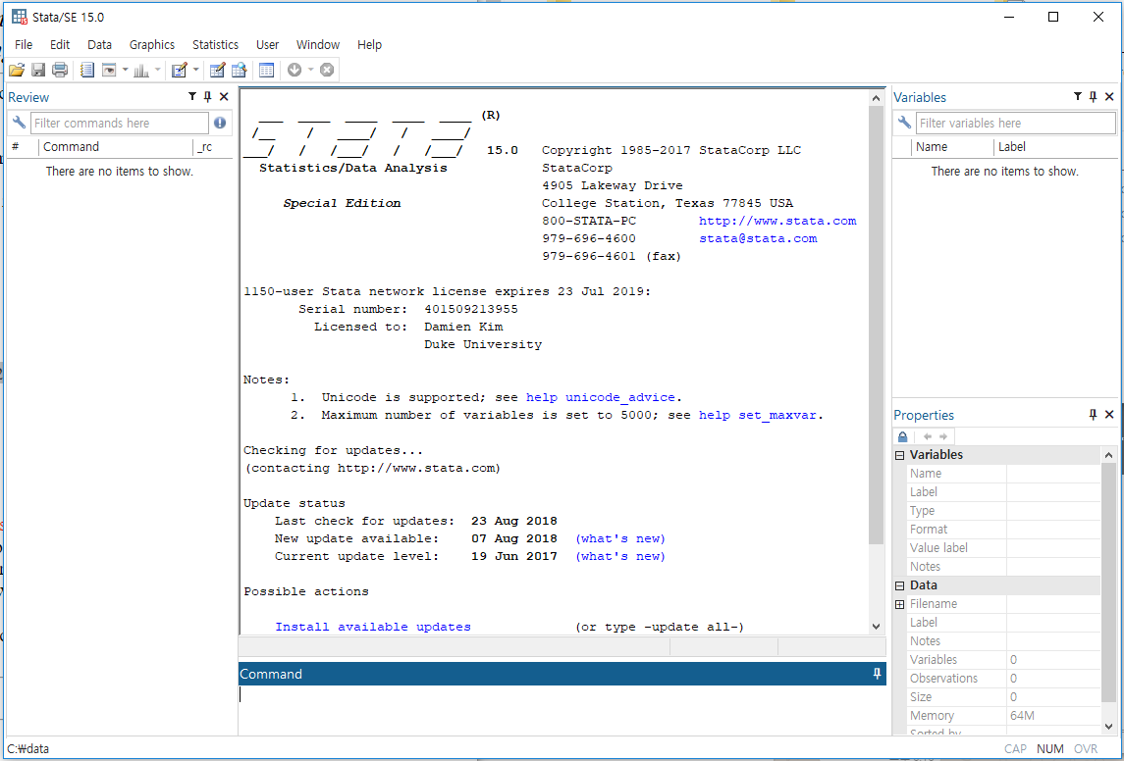
List of variables in the dataset
History of commands
Output will be here
Property of each variable
Write commands here (Terminal)
3

Slide 4
Open a data file
STATA datasets are saved as “.dta” files
STATA lets you analyze and manipulate data, so we first need to load in data!
To do this, you need to tell STATA where to look in your computer’s files for the dataset
“Setting your working directory”
4

Slide 5
Set working directory
Figure out which folder your data file is in
Let’s try using “expend.dta.” I saved the file into my “Downloads” folder
Type into the STATA terminal “cd FILEPATH HERE” to tell STATA this is the folder you want to work in
Windows: “cd c:\Downloads” or “cd Downloads”
Mac: “cd /Users/richa/Downloads” or “cd Downloads”
You need to set working directory every time you read in data
5

Slide 6
Open a data file (cont.)
After setting our working directory to the folder that the data is in, we now tell STATA the name of the dataset to use
Command: use filename.dta
Example: use expend.dta
Purpose: Loads in the dataset expend.dta
If we already have a dataset loaded into STATA, then you type instead: use expend.dta, clear
Warning: This does not save the changes made to the old dataset
We could have instead used “clear” or “clear all” to close any open datasets in STATA
6

Slide 7
Save changes to a data file
Let’s try saving expend.dta
Command: save filename.dta
Example: save expend.dta
Purpose: Saves the dataset expend.dta
This code doesn’t work! STATA says this file already exists. We have 2 options:
Choose a different filename: save expend2.dta
Replace the existing file: save expend.dta, replace
7

Slide 8
3 main types of files
Data file (STATA datasets like expend.dta)
Do file
List of “commands”, or the specific code to tell STATA to do something to your data
Allows you to keep track of what you’ve done
Log file
Documents your results
Outputs the result of the commands in Do-File
8

Slide 9
What is a do file??
Do-file is a text file containing commands
Reminder: Commands are specific code telling STATA to do something to our data
“cd Downloads” or “use expend.dta”
If we need to do similar analyses over and over, we want to keep a record of what we did
Also helps you to collaborate with others
Easier to debug when we run into errors
9

Slide 10
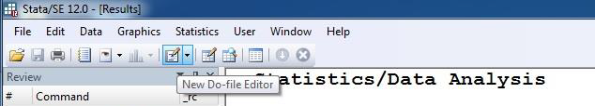
Basic do file
Step 1: Create a do-file
Step 2: Change working directory to where your data file is
I put this line at the top of all of my do-files, since you need to set working directory first
Step 3: Save the do-file with a name you like
Step 4: Edit the do file
10

Slide 11
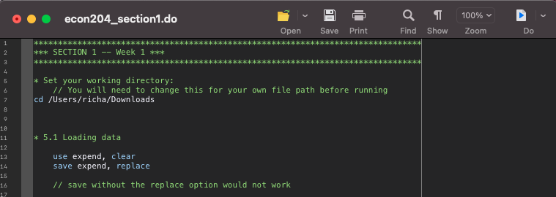
11

Slide 12
Descriptive commands
Let’s begin looking at what is in expend.dta
Simply using “describe” gives this info for all variables in the dataset
Command: describe variablenames
Example: describe tot_exp
Purpose: Shows you what the variable is and what type of variable it is (string, float [i.e. a number], etc.)
12

Slide 13
Descriptive commands (cont.)
Command: list variablenames
Example: list tot_exp
Purpose: Lists all of the values of this variable across all observations
Again, simply using “list” gives this info for all variables in the dataset
For very large datasets, we often only want to see some observations:
To see the first 10 values of tot_exp, “list tot_exp in 1/10”
To see the next 10, “list tot_exp in 11/20”
13

Slide 14
Descriptive commands (cont.)
Command: sum variablenames
Example: sum tot_exp
Purpose: Gives some summary statistics for this variable
Again, simply using “sum” gives this info for all variables in the dataset
sum tot_exp only gives us some statistics (no median??)
To see more stats, add the detail option “sum tot_exp, detail”
In STATA, options are code after the comma that impacts the command
14

Slide 15
HELP: the most useful command
What if I don’t remember what the option is called? Or, I don’t know what a command does?
Type “help commandname” into the terminal (or Google) for documentation (explanation of the command)
“help sum”
15

Slide 16
Help (cont.)
What if I want to do something but not sure the name of the command?
Type “search fill in” with what you want to do
Ex. You want to know the command for regressions, so type “search regression”
Google also works!
16

Slide 17
Descriptive commands (cont.)
Command: tab variablename
Example: tab hhsize
Purpose: Gives a frequency table of this variable
This works best for “categorical” variables or variables that don’t take on many different values
Difficult to interpret “tab tot_exp” since most values only appear once
You can also easily do a two-way frequency table:
“tab hhsize n_child”
17

Slide 18
Relationship between variables
Command: twoway scatter variablenames
Example: twoway scatter food_exp tot_exp
Purpose: Produces a scatter plot of the 2 variables
Useful to do this before looking at correlations or regressions to see if there are any major outliers (and to visually understand your data)
18

Slide 19
Relationship between variables (cont.)
Command: corr variablenames
Example: corr food_exp tot_exp
Purpose: Calculates the correlation between each pair of listed variables
Simply typing “corr” estimates the correlation between all pairs of (non-string) variables in our dataset
If you want the covariance instead, use the covariance option
“corr food_exp tot_exp, covariance”
19

Slide 20
Relationship between variables (cont.)
Command: reg depvar indepvars
Example: reg food_exp tot_exp
Purpose: Calculates regression coefficient estimates, standard errors, and useful regression stats
The first variable listed after “reg” is the dependent variable
All variables after are used as covariates / independent variables
Can do multiple covariates by simply adding more variables
“reg food_exp tot_exp hhsize”
20

Slide 21
Manipulating the data
Command: gen newvar = function of old vars
Example: gen lnexp = ln(tot_exp)
Purpose: Makes a new variable into the dataset
Can’t use the same name as an existing variable
What if I want to change an existing variable instead of making a new one?
“replace lnexp = tot_exp”
Can’t undo easily! That’s why do-files are helpful
21

Slide 22
Logical statements
We want a variable that is 1 if hhsize is >= 5 and 0 if hhsize is less than 5
We do this with “if” statements! First, make the new variable hh_gt5 equal to 1 if hhsize is greater than or equal to 5
“gen hh_gt5 = 1 if hhsize > = 5”
22

Slide 23
Logical statements (cont.)
For observations with hhsize less than 5, hh_gt5 is now missing! We want it to be 0 instead:
“replace hh_gt5 = 0 if hhsize < 4”
Could also have done “replace hh_gt5 = 0 if hh_gt5 == .”
“.” is how STATA denotes missing numeric (non-string) values
To test for equality within if statements, you need to use 2 equal signs (this is how STATA knows to check if something is true or false)
23

Slide 24
Manipulating the data (cont.)
Back to changing our current STATA dataset…
Let’s now rename the variable hhsize into householdsize
Command: rename oldvarname newvarname
Example: rename hhsize householdsize
Purpose: Change variable name
24

Slide 25
Manipulating the data (cont.)
Let’s now change the variable label for householdsize
It doesn’t matter if variable already did or did not have a variable!
Command: label variable varname “FILL IN LABEL”
Example: label variable householdsize "Number of people in household”
Purpose: Changes the variable label that you see when you describe the data
25

Slide 26
Manipulating the data (cont.)
Suppose we no longer want the householdsize variable
Command: drop varname
Example: drop householdsize
Purpose: Removes a variable from current dataset
26

Slide 27
Logical statements (cont.)
Before, we only had one condition on variable (“does hh have at least 5 ppl”)
We may have multiple conditions (“does hh have at least 5 ppl AND more than 2500 in tot_exp?”)
STATA:
and is “&”
or is “|”
Not is “!”
27

Slide 28
Logical statements (cont.)
We want variable to be 1 if hhsize is at least 5 AND tot_exp at least 2500. Variable is 0 if first is not true OR second is not true.
gen hh_big_and_rich = 1 if hhsize >= 5 & tot_exp >= 2500
replace hh_big_and_rich = 0 if hhsize < 5 | tot_exp < 2500
Could also do:
replace hh_big_and_rich = 0 if hh_big_and_rich == .
28

Slide 29
Future references
Links for STATA (https://ipl.econ.duke.edu/dthomas/ec208d/statalinks.html)
Econometrics Academy (https://sites.google.com/site/econometricsacademy/econometrics-software/stata)
Econometrics by simulation
(http://www.econometricsbysimulation.com/)
29

